Slide 1

Department of Computer Science
University Institute of Engineering
DEPARTMENT OF COMPUTER SCIENCE & ENGINEERING
Bachelor of Engineering
Subject Name: System Programming
Subject Code: CST-315
Compilers
DISCOVER . LEARN . EMPOWER

Slide 2
Parsing Types

Slide 3
Parsing Types
Parsing is classified into two categories, i.e.
Top-Down Parsing,
Bottom-Up Parsing.
Top-Down Parsing - Top-Down Parsing is based on Left Most Derivation whereas Bottom-Up Parsing is dependent on Reverse Right Most Derivation.

Slide 4
Top-Down Parsing
The process of constructing the parse tree which starts from the root and goes down to the leaf is Top-Down Parsing.
Top-Down Parsers constructs from the Grammar which is free from ambiguity and left recursion.
Top-Down Parsers uses leftmost derivation to construct a parse tree.

Slide 5
Top-Down Parsing
The process of constructing the parse tree which starts from the root and goes down to the leaf is Top-Down Parsing.
Top-Down Parsers constructs from the Grammar which is free from ambiguity and left recursion.
Top-Down Parsers uses leftmost derivation to construct a parse tree.

Slide 6
Top-Down Parsing
In Top-down parsing, we know that the parse tree is generated in the top to bottom fashion (i.e. from root to leaves).
It derives the leftmost string and when the string matches the requirement it is terminated.
The top-down parsing is mainly intended to discover the suitable production rules to generate the correct results.

Slide 7
Top-Down Parsing
Example
We will understand the top-down parsing process using an example, where the considered grammar is given below:
S –> xPz P –> yw|y

Slide 8
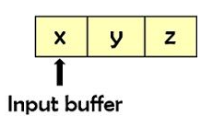
Top-Down Parsing
S –> xPz P –> yw|y
Assume that the input string is “xyz” as shown below,
The parse tree of the given input string is generated using the above-given grammar by the following steps of the top-down approach.

Slide 9
Top-Down Parsing
S –> xPz P –> yw|y
W = “xyz”
In the first step the leftmost leaf is compared with the first input symbol and it matches. So, the input pointer is shifted to the next symbol. Here, the next symbol is P which is expanded further according to grammar.
We derive yw from P (P –> yw) using the first production rule, as a result, the produced string doesn’t match the input string as it has additional symbol w. Therefore, we backtrack (go to the previous) to check whether there is another alternative or not. The other production rule that we can use is P –> y, which matches to the input string.

Slide 10
Top-Down Parsing
S –> xPz P –> yw|y
W = “xyz”
In the first step the leftmost leaf is compared with the first input symbol and it matches. So, the input pointer is shifted to the next symbol. Here, the next symbol is P which is expanded further according to grammar.
We derive yw from P (P –> yw) using the first production rule, as a result, the produced string doesn’t match the input string as it has additional symbol w. Therefore, we backtrack (go to the previous) to check whether there is another alternative or not. The other production rule that we can use is P –> y, which matches to the input string.
At last we check for the last terminal z and it also matches the grammar. Hence, the process is ceased and declared that the parsing is completed successfully.

Slide 11
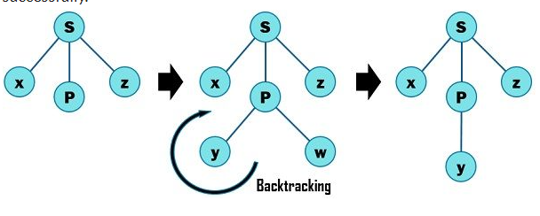
Top-Down Parsing

Slide 12
Bottom-Up Parsing

Slide 13
Bottom-Up Parsing
Bottom-up parsing - method is just inverse of top-down where the input string is taken in the first place and then the string is reduced using the grammar.
In this process the start symbol is acquired at the end of the process then it halts.
As mentioned above the tree is constructed from leaves to the root, and the input symbols are located at the leaf nodes after successful execution of the parsing method.

Slide 14
Bottom-Up Parsing
We have used the term reduction what is actually means?
The parser in the process attempts to recognize the RHS of production rule and substitute the corresponding LHS on it, this is known as reduction.
Thence, the bottom-up parse tree is constructed from the end leaves, the leaves are further reduced to the internal nodes, and internal nodes are reduced to the root node, as shown in the below-given equation.

Slide 15
Non-terminal for the internal node = Non-terminal ∪ Terminal
Example - Let us assume the token stream is “a+b” whose parse tree is constructed according to the below-given grammar.
G, S –> S * S | S + S | S – S | a | b
In the very first step, the input string a + b generates S + B by reducing a to S, using the production S –> a.
The second reduction produces S + S by reducing b to S, using the production S –> b.
In the last step the S + S is reduced to S (start symbol), with the help of S –> S + S production.

Slide 16
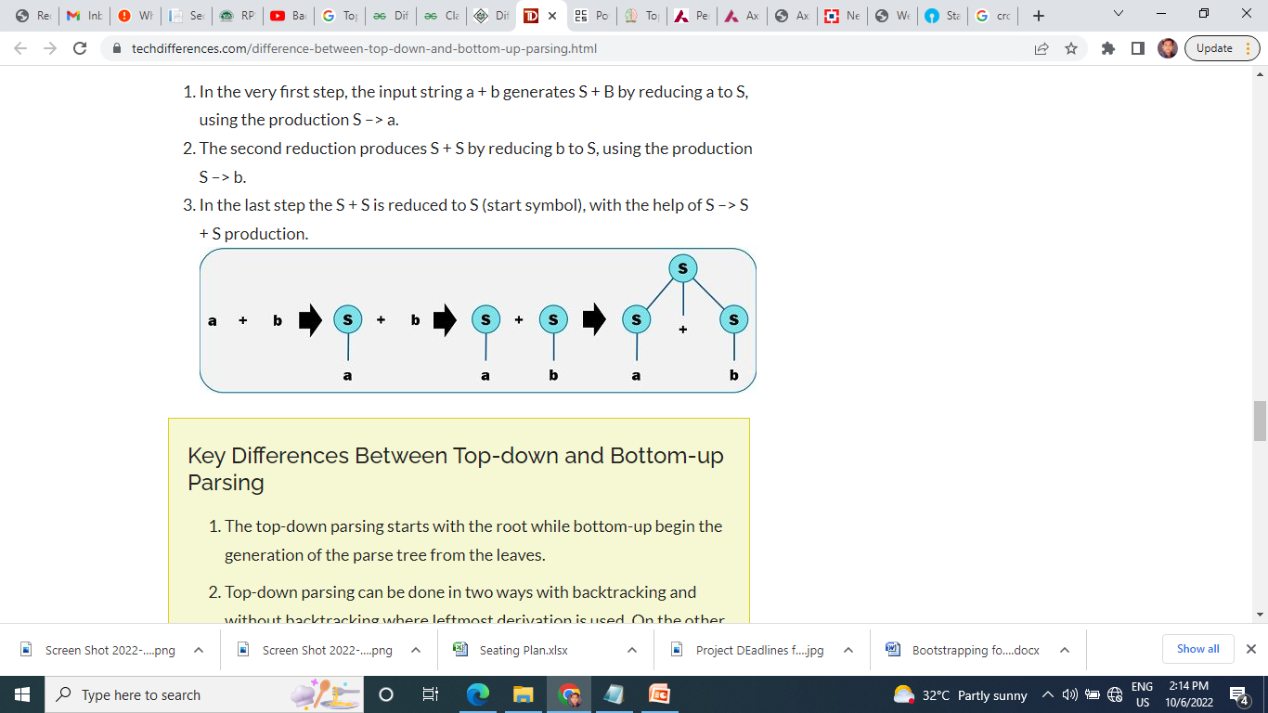
Example - Let us assume the token stream is “a+b” whose parse tree is constructed according to the below-given grammar.
G, S –> S * S | S + S | S – S | a | b
In the very first step, the input string a + b generates S + B by reducing a to S, using the production S –> a.
The second reduction produces S + S by reducing b to S, using the production S –> b.
In the last step the S + S is reduced to S (start symbol), with the help of S –> S + S production.

Slide 17
Key Differences Between Top-down and Bottom-up Parsing

Slide 18
Key Differences Between Top-down and Bottom-up Parsing
1. The top-down parsing starts with the root
while bottom-up begin the generation of the parse tree from the leaves.
2. Top-down parsing can be done in two ways with backtracking and without backtracking where leftmost derivation is used.
On the other hand, the bottom-up parsing uses a shift-reduce method where the symbol is pushed and then popped from the queue. It employs rightmost derivation.

Slide 19
Key Differences Between Top-down and Bottom-up Parsing
3. Bottom-up parsing is more powerful than the top-down parsing.
4.It is difficult to produce a bottom-up parser. As against, a top-down parser can be easily structured and formed.

Slide 20
Limitations of top-down parsing

Slide 21
Limitations of top-down parsing
Backtracking: It is a method of expanding non-terminal symbol where one alternative could be selected until any mismatch occurs otherwise another alternative is checked.
Left recursion: This result in a serious problem where the top down parser could enter an infinite loop.
Ambiguity: Ambiguous grammar creates more than one parse tree of the single string which is not acceptable in top-down parsing and need to be eliminated.

Slide 22
Limitations of bottom-up parsing

Slide 23
Limitations of bottom-up parsing
The major disadvantage of the bottom up parser is the production of the ambiguous grammar.
We know that it generates more than one parse tree which must be eliminated.
However, the operator precedence parser in bottom-up parser could also work with the ambiguous grammar.

Slide 24
Types of Parser
Top-Down Parser
Bottom Up Parse
(Shift Reduced Parser)
Operator Precedence Parser
LR Parser
Backtracking
Predictive Parser
SLR
LR
LALR
CLR

Slide 25
Types of Parser
Top-Down Parser
Bottom Up Parse
(Shift Reduced Parser)
Operator Precedence Parser
LR Parser
Backtracking
Predictive Parser
SLR
LR
LALR
CLR

Slide 26
Top-Down Approach
S → aABe
A→ bc
B→d
W = abcde
S
a A B e
b c d

Slide 27
Top-Down Parser
Recursive Descent
Backtracking
Predictive Parser
LL Parse
With the Help of LL parser we solve Predictive Parser

Slide 28
Top-Down Parser
Recursive Descent
Backtracking
Predictive Parser
LL Parse
With the Help of LL parser we solve Predictive Parser

Slide 29
Top-Down Parser (TDP)
Top-Down Parser (TDP) -
Internally uses Left most Derivation
Constructed from the grammar if is free from the ambiguity
Left Recursion
TDP
With Backtracking – Brute Fore Technique
Without Backtracking – Predictive Parser →LL

Slide 30
Top-Down Parser
Recursive Descent
Backtracking
Predictive Parser
LL Parse
With the Help of LL parser we solve Predictive Parser

Slide 31
Top-Down Parser (TDP)
Recursive Descent Parsing →
Parse is constructed from top to down
2. Input is read from left to Right
3. Input is recursively parsed for preparing parse tree with or without backtracking
A recursive descent parsing program has a set of procedures. There is one procedure for each of the non-terminal present in the grammar. The parsing starts with the execution of the procedure meant for the starting symbol.

Slide 32
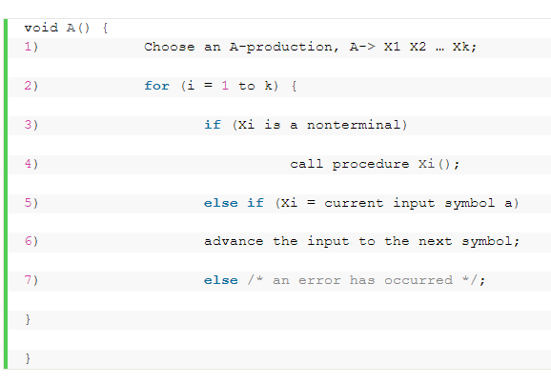
Recursive Descent Parsing

Slide 33
Recursive Descent Parsing
The pseudo code above expresses the procedure for a typical non-terminal.
This pseudocode is non-deterministic.
In the recursive descent parsing, there may be some cases where we may need backtracking.
Backtracking is scanning the provided input string by parser repeatedly.

Slide 34
Recursive Descent Parsing
Backtracking in Top-Down Parsing
If one production of a non-terminal fails in deriving the input string.
The parser has to go back to the position where it has chosen the production.
And start deriving the string again using another production of the same nonterminal.
This process may need repeated scans over the input string and we refer to it as backtracking.
Note: Backtracking parsers are rarely used. This is because they are quite inefficient in parsing the programming language.

Slide 35
Recursive Descent Parsing
To allow backtracking the above pseudocode requires the following modifications.
Instead of choosing a unique A production at line 1, we must try each of several productions in grammar in some order.

Slide 36
Recursive Descent Parsing
To allow backtracking the above pseudocode requires the following modifications.
2. The failure declared at line 7 is not an ultimate failure.
Hence, it must suggest to return to line 1 again and apply another A production. And if no more A productions are left to apply then it must declare an error in the input string.

Slide 37
Recursive Descent Parsing
To allow backtracking the above pseudocode requires the following modifications.
3. To try another A production, there must be some means to reset the input pointer. That means the input pointer must point back at the position where it was first when we have executed line 1.

Slide 38
Recursive Descent Parsing
Example of Recursive Descent Top-Down Parsing
S -> a A d A -> b | b c
input string provided to the parser is ‘abcd’.
We will start building the parse tree with the start symbol S and the input pointer points to the first symbol of the input string i.e. ‘a’.
As the start symbol ‘S’ has only one production in its production’s body. So, we will expand the symbol ‘S’.

Slide 39
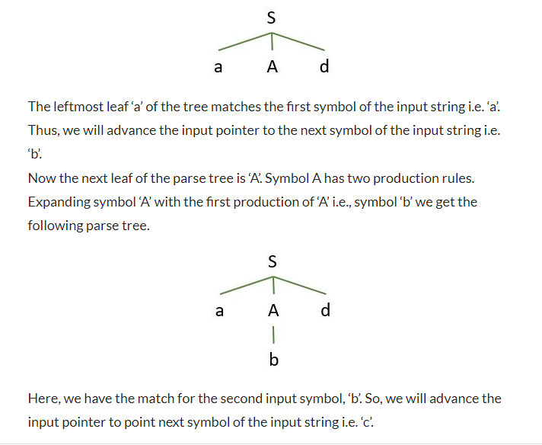
Recursive Descent Parsing
S -> a A d A -> b | b c
input string is ‘abcd’.

Slide 40
Recursive Descent Parsing
S -> a A d A -> b | b c
input string is ‘abcd’.
Now, when we compare the third input symbol ‘c’ against the next leaf labelled ‘d’ we get a mismatch. So, the parser needs to go back to the symbol ‘A’ and look for the other alternative.

Slide 41
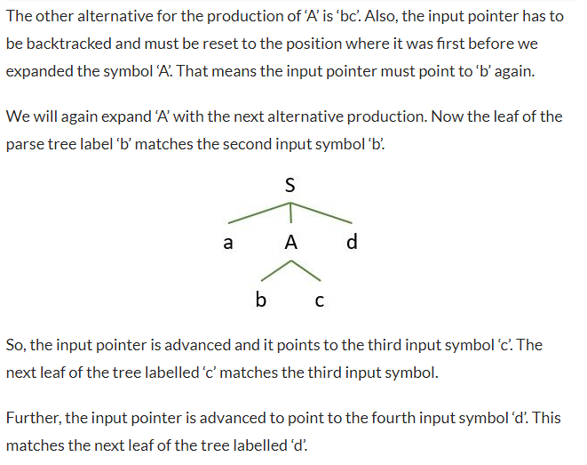
Recursive Descent Parsing
S -> a A d A -> b | b c
input string is ‘abcd’.

Slide 42
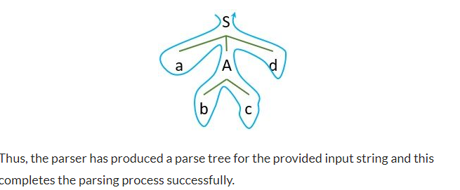
Recursive Descent Parsing
S -> a A d A -> b | b c
input string is ‘abcd’.

Slide 43
Predictive Parsing

Slide 44
Predictive Parsing
Predictive parsing is a simple form of recursive descent parsing.
It requires no backtracking.
Instead, it can determine which A-production must be chosen to derive the input string.
Predictive parsing chooses the correct A-production by looking ahead at the input string.
It allows looking ahead a fixed number of input symbols from the input string.

Slide 45
Predictive Parsing
Components of Predictive top-down Parser
Predictive top-down parsing program maintains three components:
Stack: A predictive parser maintains a stack containing a sequence of grammar symbols.
Input Buffer: It contains the input string that the predictive parser has to parse.
Parsing Table: With the entries of this table it becomes easy for the top-down parser to choose the production to be applied.

Slide 46
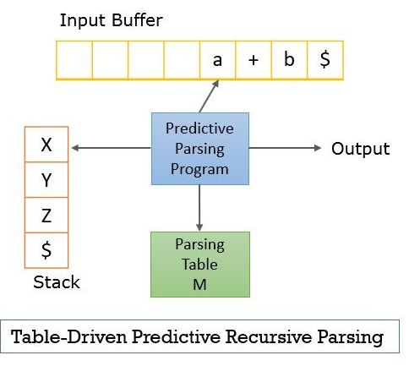
Predictive Parsing

Slide 47
Predictive Parsing
Input buffer and stack both contain the end marker ‘$’.
It indicates the bottom of the stack and the end of the input string in the input buffer

Slide 48
Predictive Parsing
Steps to perform predictive parsing:
The parser first considers the grammar symbol present on the top of the stack say ‘X’. And compares it with the current input symbol say ‘a’ present in the input buffer.
If X is a non-terminal then the parser chooses a product of X from the parse table, consulting the entry M [X, a].
In case, X is a terminal then the parser checks it for a match with the current symbol ‘a’.
This is how predictive parsing identifies the correct production. So that it can successfully derive the input string.

Slide 49
Predictive Parsing
LL Parsing
The LL parser is a predictive parser that doesn’t need backtracking.
LL (1) parser accepts only LL (1) grammar.
First L in LL (1) indicates that the parser scans the inputs string from left to right.
Second L determines the leftmost derivation for the input string.
The ‘1’ in LL (1) indicates that the parser lookahead only one input symbol from the input string.
LL (1) grammar does not include left recursion and there is no ambiguity in the LL (1) grammar.

Slide 50
Predictive Parsing

Slide 51
Problem

Slide 52
problem
predictive parsing only works for grammars where the first terminal symbol in the input provides enough information to choose which production to use
LL(1)
when parsing L, if !tok = ID, the parser cannot determine which production to use:
6. L ::= E (E could be ID)
7. | L , E (L could be E could be ID)

Slide 53
Elimination of Left Recursion

Slide 54
Consider productions S → S a | a
Problem here is left-recursive grammar: one that has a non-terminal S
S →⁺ Sα for some α

Slide 55
Elimination of Left Recursion
Consider the left-recursive grammar
S → S α | β
S generates all strings starting with a β and followed by a number of α
Can rewrite using right-recursion
S → β S’
S’ → α S’ | ε

Slide 56
Elimination of left Recursion. Example
Can rewrite using right-recursion
S → β S’
S’ → α S’ | ε
Consider the grammar
S → S 0 | 1 ( β = 1 and α = 0 )
can be rewritten as
S → 1 S’
S’ → 0 S’ | ε

Slide 57
More Elimination of Left Recursion
In general
S → S α₁ | … | S α_{n} | β₁ | … | β_{m}
All strings derived from S start with one of β₁,…,β_{m} and continue with several instances of α₁,…,α_{n}
Rewrite as
S → β₁ S’ | … | β_{m} S’
S’ → α₁ S’ | … | α_{n} S’ | ε

Slide 58
General Left Recursion
The grammar
S → A α | δ (1)
A → S β (2)
is also left-recursive because
S →⁺ S β α
This left recursion can also be eliminated by first substituting (2) into (1)
There is a general algorithm (e.g. Aho, Sethi, Ullman §4.3)
But personally, I’d just do this by hand.

Slide 59
An Alternative Approach
Instead of reordering or rewriting grammar, can use top-down breadth-first search.
S → S a | a String: aaa
S
S a a (string not all matched)
S a a a a
S a a a a a a

Slide 60
Summary of Top-Down Parsing So Far
Simple and general parsing strategy
Left recursion must be eliminated first
Backtracking (depth-first) can make it slow

Slide 61
Predictive Parsers
Modification of depth-first parsing in which parser “predicts” which production to use
By looking at the next few tokens
No backtracking
Predictive parsers accept LL(k) grammars
L means “left-to-right” scan of input
L means “leftmost derivation”
k means “predict based on k tokens of lookahead”
In practice, LL(1) is used

Slide 62
Left Factoring

Slide 63
Left Factoring
With the grammar
E → T + E | T
T → int | int * T | ( E )
Impossible to predict because
For T two productions start with int
For E it is not clear how to predict
A grammar must be left-factored before use for predictive parsing

Slide 64
Left-Factoring Example
Starting with the grammar
E → T + E | T
T → int | int * T | ( E )
Factor out common prefixes of productions
E → T X ( Common Taken common here is T )
X → + EX | ε
T → int Y | ( E )
Y → ε | * TY

Slide 65
Example: Consider the following grammar :
E→E+T|T
T→T*F|F
F→(E)|id

Slide 66
Example of LL(1) grammar
After eliminating left-recursion the grammar is
E →TE’
E’ → +TE’ | ε
T →FT’
T’ → *FT’ | ε
F → (E)|id
E→E+T|T
T→T*F|F
F→(E)|id

Slide 67
Left-Factoring Example
Starting with the grammar
E → T + E | T
T → int | int * T | ( E )
E→E+T|T
T→T*F|F
F→(E)|id
Factor out common prefixes of productions
E → T X ( Common Taken common here is T )
X → + EX | ε
T → int Y | ( E )
Y → ε | * TY
E →TE’
E’ → +TE’ | ε
T →FT’
T’ → *FT’ | ε
F → (E)|id

Slide 68
FIRST()
E →TE’
E’ → +TE’ | ε
T →FT’
T’ → *FT’ | ε
F → (E)|id
First(E ) → First(TE’)→ First(T)→first(FT’)→First(F)→{(,id}
First(E’ ) → {+, ε}
First(T)→first(FT’)→First(F)→{(,id}
First(T’)→ {*, ε}
First(F)→{(,id}

Slide 69
FIRST()
E →TE’
E’ → +TE’ | ε
T →FT’
T’ → *FT’ | ε
F → (E)|id
First(E ) → First(TE’)→ First(T)→first(FT’)→First(F)→{(,id}
First(E’ ) → {+, ε}
First(T)→first(FT’)→First(F)→{(,id}
First(T’)→ {*, ε}
First(F)→{(,id}
First( ) :
FIRST(E) = { ( , id}
FIRST(E’) ={+ , ε }
FIRST(T) = { ( , id}
FIRST(T’) = {*, ε }
FIRST(F) = { ( , id }

Slide 70
E →TE’
E’ → +TE’ | ε
T →FT’
T’ → *FT’ | ε
F → (E)|id
First( ) :
FIRST(E) = { ( , id}
FIRST(E’) ={+ , ε }
FIRST(T) = { ( , id}
FIRST(T’) = {*, ε }
FIRST(F) = { ( , id }

Slide 71
First( ) :
FIRST(E) = { ( , id}
FIRST(E’) ={+ , ε }
FIRST(T) = { ( , id}
FIRST(T’) = {*, ε }
FIRST(F) = { ( , id }
Follow( ):
FOLLOW(E) =
E →TE’
E’ → +TE’ | ε
T →FT’
T’ → *FT’ | ε
F → (E)|id
Rules for follow( ):
1. If S is a start symbol, then FOLLOW(S) contains $.
2. If there is a production A → αBβ, then follow(B)= FIRST(β) except ε
3. If there is a production A → αB, or a production A → αBβ if
FIRST(β) contains ε,
then follow(B)= FOLLOW(A)

Slide 72
First( ) :
FIRST(E) = { ( , id}
FIRST(E’) ={+ , ε }
FIRST(T) = { ( , id}
FIRST(T’) = {*, ε }
FIRST(F) = { ( , id }
Follow( ):
FOLLOW(E) = rule 1
E →TE’
E’ → +TE’ | ε
T →FT’
T’ → *FT’ | ε
F → (E)|id
Rules for follow( ):
1. If S is a start symbol, then FOLLOW(S) contains $.
2. If there is a production A → αBβ, then follow(B)= FIRST(β) except ε
3. If there is a production A → αB, or a production A → αBβ if
FIRST(β) contains ε,
then follow(B)= FOLLOW(A)

Slide 73
First( ) :
FIRST(E) = { ( , id}
FIRST(E’) ={+ , ε }
FIRST(T) = { ( , id}
FIRST(T’) = {*, ε }
FIRST(F) = { ( , id }
Follow( ):
FOLLOW(E) = { $,
E →TE’
E’ → +TE’ | ε
T →FT’
T’ → *FT’ | ε
F → (E)|id
Rules for follow( ):
1. If S is a start symbol, then FOLLOW(S) contains $.
2. If there is a production A → αBβ, then follow(B)= FIRST(β) except ε
3. If there is a production A → αB, or a production A → αBβ if
FIRST(β) contains ε,
then follow(B)= FOLLOW(A)

Slide 74
First( ) :
FIRST(E) = { ( , id}
FIRST(E’) ={+ , ε }
FIRST(T) = { ( , id}
FIRST(T’) = {*, ε }
FIRST(F) = { ( , id }
Follow( ):
FOLLOW(E) = { $, ) }
E →TE’
E’ → +TE’ | ε
T →FT’
T’ → *FT’ | ε
F → (E)|id
Rules for follow( ):
1. If S is a start symbol, then FOLLOW(S) contains $.
2. If there is a production A → αBβ, then follow(B)= FIRST(β) except ε
3. If there is a production A → αB, or a production A → αBβ if
FIRST(β) contains ε,
then follow(B)= FOLLOW(A)

Slide 75
First( ) :
FIRST(E) = { ( , id}
FIRST(E’) ={+ , ε }
FIRST(T) = { ( , id}
FIRST(T’) = {*, ε }
FIRST(F) = { ( , id }
Follow( ):
FOLLOW(E) = { $, ) }
FOLLOW(E’) = Rule 3
E →TE’
E’ → +TE’ | ε
T →FT’
T’ → *FT’ | ε
F → (E)|id
Rules for follow( ):
1. If S is a start symbol, then FOLLOW(S) contains $.
2. If there is a production A → αBβ, then follow(B)= FIRST(β) except ε
3. If there is a production A → αB, or a production A → αBβ if
FIRST(β) contains ε,
then follow(B)= FOLLOW(A)

Slide 76
First( ) :
FIRST(E) = { ( , id}
FIRST(E’) ={+ , ε }
FIRST(T) = { ( , id}
FIRST(T’) = {*, ε }
FIRST(F) = { ( , id }
Follow( ):
FOLLOW(E) = { $, ) }
FOLLOW(E’) = Follow (E)
E →TE’
E’ → +TE’ | ε
T →FT’
T’ → *FT’ | ε
F → (E)|id
Rules for follow( ):
1. If S is a start symbol, then FOLLOW(S) contains $.
2. If there is a production A → αBβ, then follow(B)= FIRST(β) except ε
3. If there is a production A → αB, or a production A → αBβ if
FIRST(β) contains ε,
then follow(B)= FOLLOW(A)

Slide 77
First( ) :
FIRST(E) = { ( , id}
FIRST(E’) ={+ , ε }
FIRST(T) = { ( , id}
FIRST(T’) = {*, ε }
FIRST(F) = { ( , id }
Follow( ):
FOLLOW(E) = { $, ) }
FOLLOW(E’) = { $, ) }
E →TE’
E’ → +TE’ | ε
T →FT’
T’ → *FT’ | ε
F → (E)|id
Rules for follow( ):
1. If S is a start symbol, then FOLLOW(S) contains $.
2. If there is a production A → αBβ, then follow(B)= FIRST(β) except ε
3. If there is a production A → αB, or a production A → αBβ if
FIRST(β) contains ε,
then follow(B)= FOLLOW(A)

Slide 78
First( ) :
FIRST(E) = { ( , id}
FIRST(E’) ={+ , ε }
FIRST(T) = { ( , id}
FIRST(T’) = {*, ε }
FIRST(F) = { ( , id }
Follow( ):
FOLLOW(E) = { $, ) }
FOLLOW(E’) = { $, ) }
FOLLOW(T) =
E →TE’
E’ → +TE’ | ε
T →FT’
T’ → *FT’ | ε
F → (E)|id
Rules for follow( ):
1. If S is a start symbol, then FOLLOW(S) contains $.
2. If there is a production A → αBβ, then follow(B)= FIRST(β) except ε
3. If there is a production A → αB, or a production A → αBβ if
FIRST(β) contains ε,
then follow(B)= FOLLOW(A)

Slide 79
First( ) :
FIRST(E) = { ( , id}
FIRST(E’) ={+ , ε }
FIRST(T) = { ( , id}
FIRST(T’) = {*, ε }
FIRST(F) = { ( , id }
Follow( ):
FOLLOW(E) = { $, ) }
FOLLOW(E’) = { $, ) }
FOLLOW(T) = First(E’)
E →TE’
E’ → +TE’ | ε
T →FT’
T’ → *FT’ | ε
F → (E)|id
Rules for follow( ):
1. If S is a start symbol, then FOLLOW(S) contains $.
2. If there is a production A → αBβ, then follow(B)= FIRST(β) except ε
3. If there is a production A → αB, or a production A → αBβ if
FIRST(β) contains ε,
then follow(B)= FOLLOW(A)

Slide 80
First( ) :
FIRST(E) = { ( , id}
FIRST(E’) ={+ , ε }
FIRST(T) = { ( , id}
FIRST(T’) = {*, ε }
FIRST(F) = { ( , id }
Follow( ):
FOLLOW(E) = { $, ) }
FOLLOW(E’) = { $, ) }
FOLLOW(T) = { +, ε
E →TE’
E’ → +TE’ | ε
T →FT’
T’ → *FT’ | ε
F → (E)|id
Rules for follow( ):
1. If S is a start symbol, then FOLLOW(S) contains $.
2. If there is a production A → αBβ, then follow(B)= FIRST(β) except ε
3. If there is a production A → αB, or a production A → αBβ if
FIRST(β) contains ε,
then follow(B)= FOLLOW(A)

Slide 81
First( ) :
FIRST(E) = { ( , id}
FIRST(E’) ={+ , ε }
FIRST(T) = { ( , id}
FIRST(T’) = {*, ε }
FIRST(F) = { ( , id }
Follow( ):
FOLLOW(E) = { $, ) }
FOLLOW(E’) = { $, ) }
FOLLOW(T) = { +, $, ) }
E →TE’
E’ → +TE’ | ε
T →FT’
T’ → *FT’ | ε
F → (E)|id
Rules for follow( ):
1. If S is a start symbol, then FOLLOW(S) contains $.
2. If there is a production A → αBβ, then follow(B)= FIRST(β) except ε
3. If there is a production A → αB, or a production A → αBβ if
FIRST(β) contains ε,
then follow(B)= FOLLOW(A)

Slide 82
First( ) :
FIRST(E) = { ( , id}
FIRST(E’) ={+ , ε }
FIRST(T) = { ( , id}
FIRST(T’) = {*, ε }
FIRST(F) = { ( , id }
Follow( ):
FOLLOW(E) = { $, ) }
FOLLOW(E’) = { $, ) }
FOLLOW(T) = { +, $, ) }
E →TE’
E’ → +TE’ | ε
T →FT’
T’ → *FT’ | ε
F → (E)|id
Rules for follow( ):
1. If S is a start symbol, then FOLLOW(S) contains $.
2. If there is a production A → αBβ, then follow(B)= FIRST(β) except ε
3. If there is a production A → αB, or a production A → αBβ if
FIRST(β) contains ε,
then follow(B)= FOLLOW(A)

Slide 83
First( ) :
FIRST(E) = { ( , id}
FIRST(E’) ={+ , ε }
FIRST(T) = { ( , id}
FIRST(T’) = {*, ε }
FIRST(F) = { ( , id }
Follow( ):
FOLLOW(E) = { $, ) }
FOLLOW(E’) = { $, ) }
FOLLOW(T) = { +, $, ) }
FOLLOW(T’) =
E →TE’
E’ → +TE’ | ε
T →FT’
T’ → *FT’ | ε
F → (E)|id
Rules for follow( ):
1. If S is a start symbol, then FOLLOW(S) contains $.
2. If there is a production A → αBβ, then follow(B)= FIRST(β) except ε
3. If there is a production A → αB, or a production A → αBβ if
FIRST(β) contains ε,
then follow(B)= FOLLOW(A)

Slide 84
First( ) :
FIRST(E) = { ( , id}
FIRST(E’) ={+ , ε }
FIRST(T) = { ( , id}
FIRST(T’) = {*, ε }
FIRST(F) = { ( , id }
Follow( ):
FOLLOW(E) = { $, ) }
FOLLOW(E’) = { $, ) }
FOLLOW(T) = { +, $, ) }
FOLLOW(T’) = Rule 3
E →TE’
E’ → +TE’ | ε
T →FT’
T’ → *FT’ | ε
F → (E)|id
Rules for follow( ):
1. If S is a start symbol, then FOLLOW(S) contains $.
2. If there is a production A → αBβ, then follow(B)= FIRST(β) except ε
3. If there is a production A → αB, or a production A → αBβ if
FIRST(β) contains ε,
then follow(B)= FOLLOW(A)

Slide 85
First( ) :
FIRST(E) = { ( , id}
FIRST(E’) ={+ , ε }
FIRST(T) = { ( , id}
FIRST(T’) = {*, ε }
FIRST(F) = { ( , id }
Follow( ):
FOLLOW(E) = { $, ) }
FOLLOW(E’) = { $, ) }
FOLLOW(T) = { +, $, ) }
FOLLOW(T’) = FOLLOW(T)
E →TE’
E’ → +TE’ | ε
T →FT’
T’ → *FT’ | ε
F → (E)|id
Rules for follow( ):
1. If S is a start symbol, then FOLLOW(S) contains $.
2. If there is a production A → αBβ, then follow(B)= FIRST(β) except ε
3. If there is a production A → αB, or a production A → αBβ if
FIRST(β) contains ε,
then follow(B)= FOLLOW(A)

Slide 86
First( ) :
FIRST(E) = { ( , id}
FIRST(E’) ={+ , ε }
FIRST(T) = { ( , id}
FIRST(T’) = {*, ε }
FIRST(F) = { ( , id }
Follow( ):
FOLLOW(E) = { $, ) }
FOLLOW(E’) = { $, ) }
FOLLOW(T) = { +, $, ) }
FOLLOW(T’) = { +, $, ) }
E →TE’
E’ → +TE’ | ε
T →FT’
T’ → *FT’ | ε
F → (E)|id
Rules for follow( ):
1. If S is a start symbol, then FOLLOW(S) contains $.
2. If there is a production A → αBβ, then follow(B)= FIRST(β) except ε
3. If there is a production A → αB, or a production A → αBβ if
FIRST(β) contains ε,
then follow(B)= FOLLOW(A)

Slide 87
First( ) :
FIRST(E) = { ( , id}
FIRST(E’) ={+ , ε }
FIRST(T) = { ( , id}
FIRST(T’) = {*, ε }
FIRST(F) = { ( , id }
Follow( ):
FOLLOW(E) = { $, ) }
FOLLOW(E’) = { $, ) }
FOLLOW(T) = { +, $, ) }
FOLLOW(T’) = { +, $, ) }
FOLLOW(F) =
E →TE’
E’ → +TE’ | ε
T →FT’
T’ → *FT’ | ε
F → (E)|id
Rules for follow( ):
1. If S is a start symbol, then FOLLOW(S) contains $.
2. If there is a production A → αBβ, then follow(B)= FIRST(β) except ε
3. If there is a production A → αB, or a production A → αBβ if
FIRST(β) contains ε,
then follow(B)= FOLLOW(A)

Slide 88
First( ) :
FIRST(E) = { ( , id}
FIRST(E’) ={+ , ε }
FIRST(T) = { ( , id}
FIRST(T’) = {*, ε }
FIRST(F) = { ( , id }
Follow( ):
FOLLOW(E) = { $, ) }
FOLLOW(E’) = { $, ) }
FOLLOW(T) = { +, $, ) }
FOLLOW(T’) = { +, $, ) }
FOLLOW(F) = Rule 2
E →TE’
E’ → +TE’ | ε
T →FT’
T’ → *FT’ | ε
F → (E)|id
Rules for follow( ):
1. If S is a start symbol, then FOLLOW(S) contains $.
2. If there is a production A → αBβ, then follow(B)= FIRST(β) except ε
3. If there is a production A → αB, or a production A → αBβ if
FIRST(β) contains ε,
then follow(B)= FOLLOW(A)

Slide 89
First( ) :
FIRST(E) = { ( , id}
FIRST(E’) ={+ , ε }
FIRST(T) = { ( , id}
FIRST(T’) = {*, ε }
FIRST(F) = { ( , id }
Follow( ):
FOLLOW(E) = { $, ) }
FOLLOW(E’) = { $, ) }
FOLLOW(T) = { +, $, ) }
FOLLOW(T’) = { +, $, ) }
FOLLOW(F) = First(T’)
E →TE’
E’ → +TE’ | ε
T →FT’
T’ → *FT’ | ε
F → (E)|id
Rules for follow( ):
1. If S is a start symbol, then FOLLOW(S) contains $.
2. If there is a production A → αBβ, then follow(B)= FIRST(β) except ε
3. If there is a production A → αB, or a production A → αBβ if
FIRST(β) contains ε,
then follow(B)= FOLLOW(A)

Slide 90
First( ) :
FIRST(E) = { ( , id}
FIRST(E’) ={+ , ε }
FIRST(T) = { ( , id}
FIRST(T’) = {*, ε }
FIRST(F) = { ( , id }
Follow( ):
FOLLOW(E) = { $, ) }
FOLLOW(E’) = { $, ) }
FOLLOW(T) = { +, $, ) }
FOLLOW(T’) = { +, $, ) }
FOLLOW(F) = { *, ε
E →TE’
E’ → +TE’ | ε
T →FT’
T’ → *FT’ | ε
F → (E)|id
Rules for follow( ):
1. If S is a start symbol, then FOLLOW(S) contains $.
2. If there is a production A → αBβ, then follow(B)= FIRST(β) except ε
3. If there is a production A → αB, or a production A → αBβ if
FIRST(β) contains ε,
then follow(B)= FOLLOW(A)

Slide 91
First( ) :
FIRST(E) = { ( , id}
FIRST(E’) ={+ , ε }
FIRST(T) = { ( , id}
FIRST(T’) = {*, ε }
FIRST(F) = { ( , id }
Follow( ):
FOLLOW(E) = { $, ) }
FOLLOW(E’) = { $, ) }
FOLLOW(T) = { +, $, ) }
FOLLOW(T’) = { +, $, ) }
FOLLOW(F) = { *, follow(T)}
E →TE’
E’ → +TE’ | ε
T →FT’
T’ → *FT’ | ε
F → (E)|id
Rules for follow( ):
1. If S is a start symbol, then FOLLOW(S) contains $.
2. If there is a production A → αBβ, then follow(B)= FIRST(β) except ε
3. If there is a production A → αB, or a production A → αBβ if
FIRST(β) contains ε,
then follow(B)= FOLLOW(A)

Slide 92
First( ) :
FIRST(E) = { ( , id}
FIRST(E’) ={+ , ε }
FIRST(T) = { ( , id}
FIRST(T’) = {*, ε }
FIRST(F) = { ( , id }
Follow( ):
FOLLOW(E) = { $, ) }
FOLLOW(E’) = { $, ) }
FOLLOW(T) = { +, $, ) }
FOLLOW(T’) = { +, $, ) }
FOLLOW(F) = {+, * , $ , ) }
E →TE’
E’ → +TE’ | ε
T →FT’
T’ → *FT’ | ε
F → (E)|id
Rules for follow( ):
1. If S is a start symbol, then FOLLOW(S) contains $.
2. If there is a production A → αBβ, then follow(B)= FIRST(β) except ε
3. If there is a production A → αB, or a production A → αBβ if
FIRST(β) contains ε,
then follow(B)= FOLLOW(A)

Slide 93
First( ) :
FIRST(E) = { ( , id}
FIRST(E’) ={+ , ε }
FIRST(T) = { ( , id}
FIRST(T’) = {*, ε }
FIRST(F) = { ( , id }
Follow( ):
FOLLOW(E) = { $, ) }
FOLLOW(E’) = { $, ) }
FOLLOW(T) = { +, $, ) }
FOLLOW(T’) = { +, $, ) }
FOLLOW(F) = {+, * , $ , ) }
E →TE’
E’ → +TE’ | ε
T →FT’
T’ → *FT’ | ε
F → (E)|id
Rules for follow( ):
1. If S is a start symbol, then FOLLOW(S) contains $.
2. If there is a production A → αBβ, then follow(B)= FIRST(β) except ε
3. If there is a production A → αB, or a production A → αBβ if
FIRST(β) contains ε,
then follow(B)= FOLLOW(A)

Slide 94
First( ) :
FIRST(E) = { ( , id}
FIRST(E’) ={+ , ε }
FIRST(T) = { ( , id}
FIRST(T’) = {*, ε }
FIRST(F) = { ( , id }
Follow( ):
FOLLOW(E) = { $, ) }
FOLLOW(E’) = { $, ) }
FOLLOW(T) = { +, $, ) }
FOLLOW(T’) = { +, $, ) }
FOLLOW(F) = {+, * , $ , ) }
E →TE’
E’ → +TE’ | ε
T →FT’
T’ → *FT’ | ε
F → (E)|id

Slide 95
First( ) :
FIRST(E) = { ( , id}
FIRST(E’) ={+ , ε }
FIRST(T) = { ( , id}
FIRST(T’) = {*, ε }
FIRST(F) = { ( , id }
Follow( ):
FOLLOW(E) = { $, ) }
FOLLOW(E’) = { $, ) }
FOLLOW(T) = { +, $, ) }
FOLLOW(T’) = { +, $, ) }
FOLLOW(F) = {+, * , $ , ) }
E →TE’
E’ → +TE’ | ε
T →FT’
T’ → *FT’ | ε
F → (E)|id
Terminal
id + * ( ) $
Non Terminal Variables
E
E’
T
T’
F

Slide 96
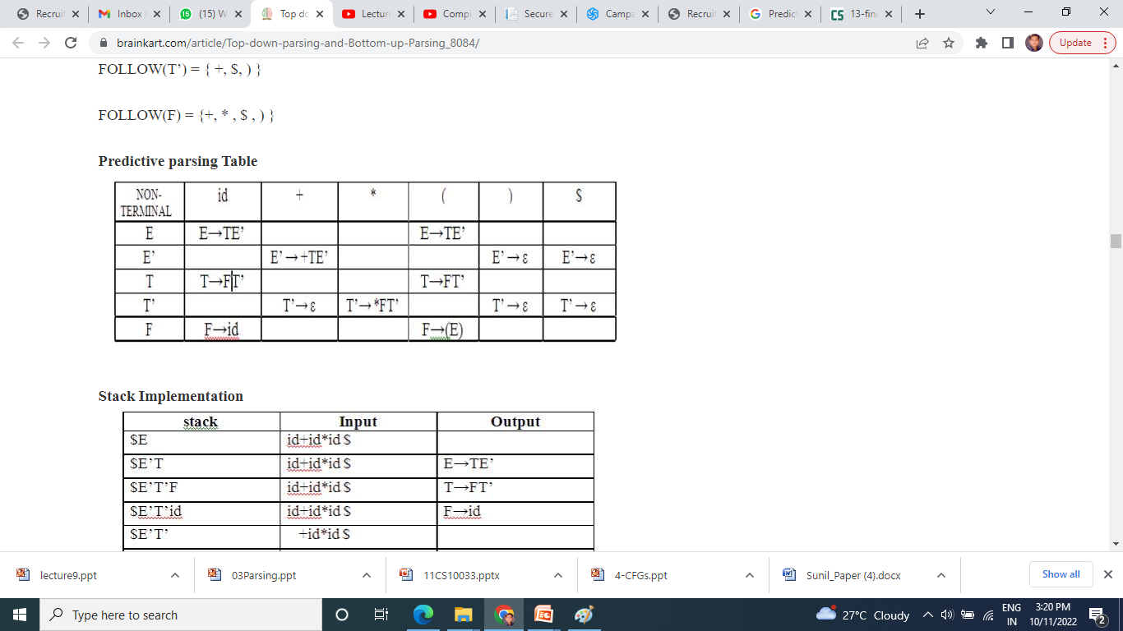
First( ) :
FIRST(E) = { ( , id}
FIRST(E’) ={+ , ε }
FIRST(T) = { ( , id}
FIRST(T’) = {*, ε }
FIRST(F) = { ( , id }
Follow( ):
FOLLOW(E) = { $, ) }
FOLLOW(E’) = { $, ) }
FOLLOW(T) = { +, $, ) }
FOLLOW(T’) = { +, $, ) }
FOLLOW(F) = {+, * , $ , ) }
E →TE’
E’ → +TE’ | ε
T →FT’
T’ → *FT’ | ε
F → (E)|id

Slide 97
Generated Parser Table For String id + id * id

Slide 98
